Slide 1
Alta Performance com Java
Java OO com Alta Performance

Slide 2
Apresentação
Atuo na área de TI desde 1996 e com Java e aplicações corporativas desde 2004. Tive a oportunidade de participar de grandes projetos para clientes como: HP, EDS, Bosch, Mitsubhishi e para os Governos de Santa Catarina, São Paulo e Mato Grosso do Sul. Atualmente me encontro imerso na cultura Ágil e palestrando em importantes eventos como Javaneiros e Flisol.
@apedrina
pedrina.alisson@gmail.com
www.alissonpedrina.wordpress.com

Slide 3
O curso
Como nasceu a idéia?
E agora?

Slide 4
Conteúdo
A tecnologia Java - O que é? - História - Presente - Futuro - Mercado de Trabalho
Performance - O que é? - Quando Testar? - O que testar? - Ferramentas - Como testar?
Arquitetura da JVM
O Modelo de Memória
Web
Agilidade
Clean Code
Entrega Contínua

Slide 5
Conteúdo
A tecnologia Java - O que é? - História - Presente - Futuro - Mercado de Trabalho
Performance
Arquitetura da JVM
O Modelo de Memória
Web
Agilidade
Clean Code
Entrega Contínua

Slide 6
História do Java
http://www.javatpoint.com/history-of-java

Slide 7
Green Team
James Gosling, Mike Sheridan, and Patrick Naughton initiated the Java language project in June 1991. The small team of sun engineers called Green Team.
Originally designed for small, embedded systems in electronic appliances like set-top boxes.
Firstly, it was called "Greentalk" by James Gosling and file extension was .gt.
After that, it was called Oak and was developed as a part of the Green project.

Slide 8
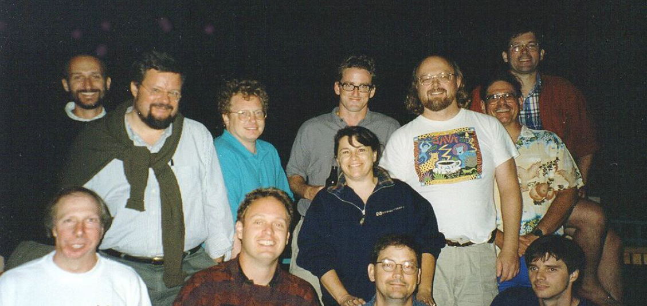
Green Team

Slide 9
Porque OAK
Oak is a symbol of strength and choosen as a national tree of many countries like U.S.A., France, Germany, Romania etc.
In 1995, Oak was renamed as "Java" because it was already a trademark by Oak Technologies.

Slide 10
Porque Java
The team gathered to choose a new name. The suggested words were "dynamic", "revolutionary", "Silk", "jolt", "DNA" etc. They wanted something that reflected the essence of the technology: revolutionary, dynamic, lively, cool, unique, and easy to spell and fun to say.
According to James Gosling "Java was one of the top choices along with Silk". Since java was so unique, most of the team members preferred java.
Java is an island of Indonesia where first coffee was produced (called java coffee).
Originally developed by James Gosling at Sun Microsystems (which is now a subsidiary of Oracle Corporation) and released in 1995.

Slide 11
Versões
JDK Alpha and Beta (1995)
JDK 1.0 (January 23, 1996) | Oak
JDK 1.1 (February 19, 1997)
J2SE 1.2 (December 8, 1998) | Playground
J2SE 1.3 (May 8, 2000) | Kestrel (hotspot)
J2SE 1.4 (February 6, 2002) | Merlin (jcp) jsr59
J2SE 5.0 (September 30, 2004) | Tiger
Java SE 6 (December 11, 2006) | Mustang
Oracle 2010
Java SE 7 (July 28, 2011) | Dolphin
Java SE 8 (March 18, 2014)

Slide 12
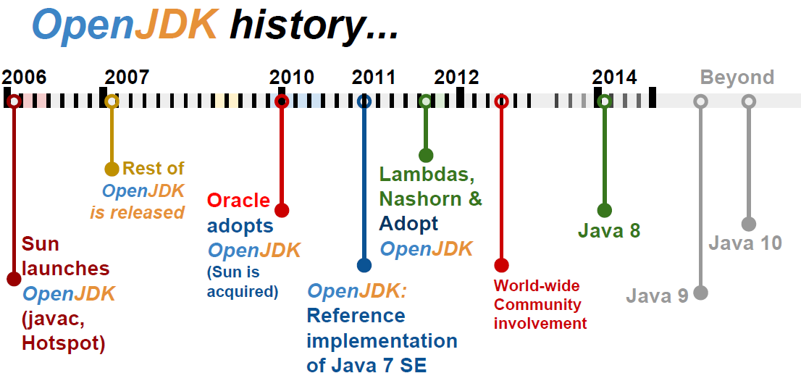
To promote and support community involvement in the development, adoption and evangelism of OpenJDK projects

Slide 13
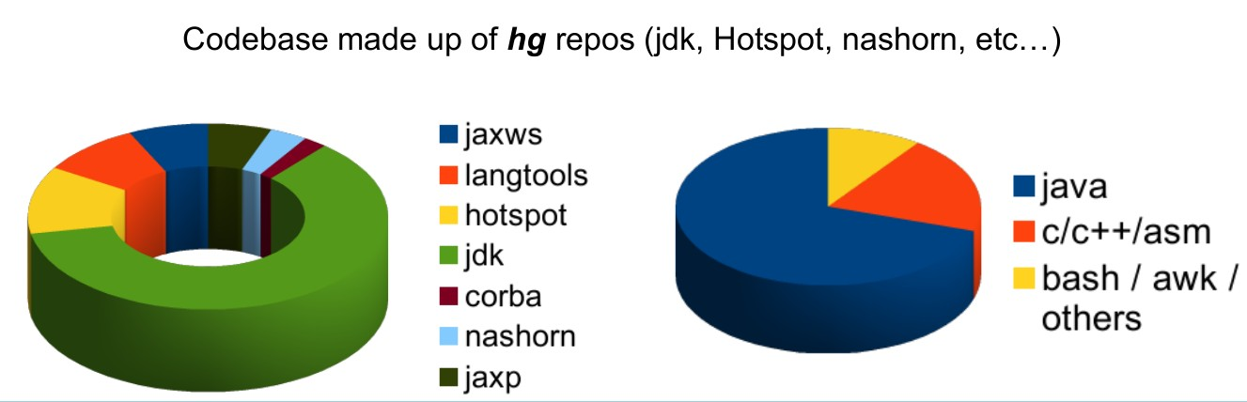
Codebase OpenJdk

Slide 14
Presente
Java hoje

Slide 15
JCP e JSR
Welcome to jcp.org, home of the Java Community ProcessSM (JCPSM) Program. The JCP is the mechanism for developing standard technical specifications for Java technology. Anyone can register for the site and participate in reviewing and providing feedback for the Java Specification Requests (JSRs), and anyone can sign up to become a JCP Member and then participate on the Expert Group of a JSR or even submit their own JSR Proposals.

Slide 16
JDK Enhancement Proposal
The JDK Enhancement Proposal (or JEP) is a process drafted by Oracle Corporation for collecting proposals for enhancements to the Java Development Kit and OpenDK.

Slide 17
Meta-circular e Linguagens Dinâmicas
Maxine - JVM
Graal VM – compilador e interpretador
Jruby
Jython
Nashorn
Scala
Groovy

Slide 18
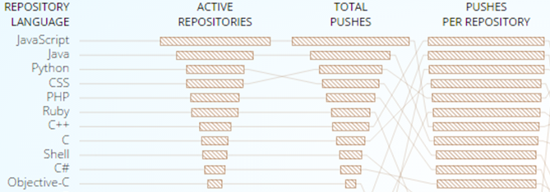
GitHub

Slide 19
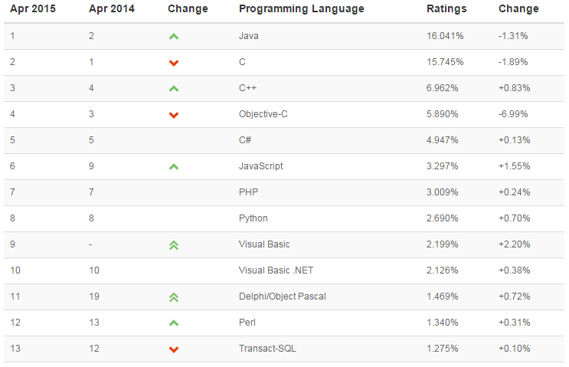
TIOB TIOBE checks more than 300 million lines of software code for its customers world-wide, real-time, each day.

Slide 20
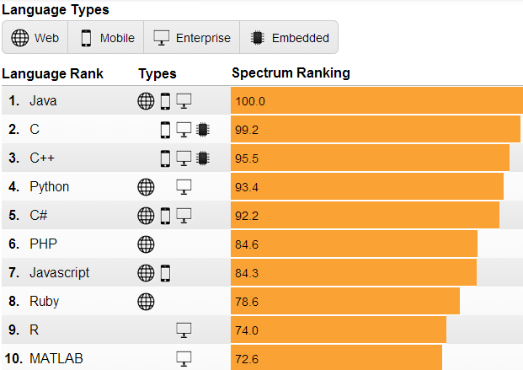
IEEE is the world's largest professional association dedicated to advancing technological innovation and excellence for the benefit of humanity.

Slide 21
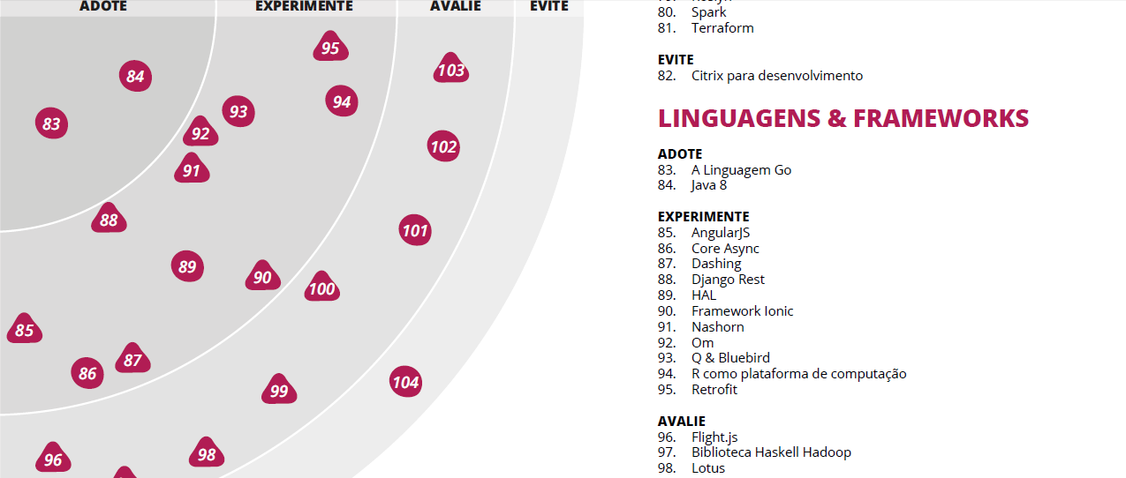
Radar thoughtworks

Slide 22
Mercado de Trabalho
No Brasil e no Mundo

Slide 23
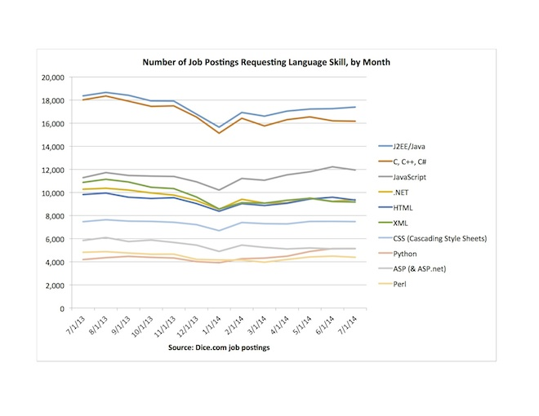
Dice.com

Slide 24
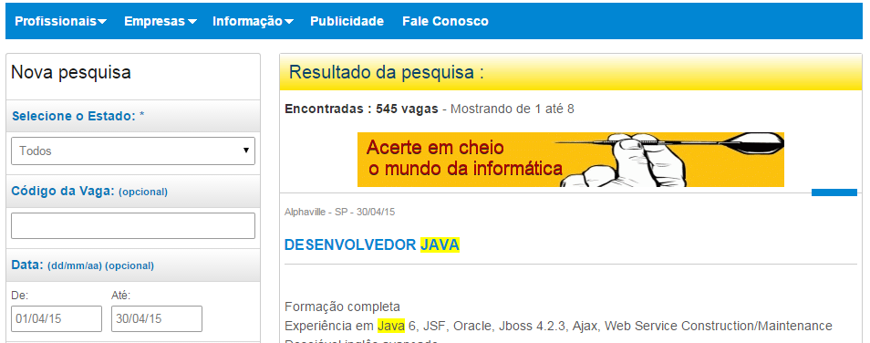
www.apinfo.com

Slide 25












Algumas empresas

